Slide 1
Advanced Automation with ARM Templates
Infrastructure as Code
Notes:
Welcome to [Module Name].

Slide 2
Introduction
Topic 1

Slide 3
Scoped Deployments

Slide 4
Which Scope to Use?
Tenant
Mgmt Group
Subscription
Resource Group
Role definitions and assignments
Policy definitions and assignments
Management groups
Role definitions and assignments
Policy definitions and assignments
Role definitions and assignments
Policy definitions, assignments and remediation
Security Center configuration
Blueprints
Resource groups
Budgets
Locks
Role assignments
Policy assignments
Most resources

Slide 5
Schema
Template Scope | Schema
Tenant | https://schema.management.azure.com/schemas/2019-08-01/ tenantDeploymentTemplate.json#
Management Group | https://schema.management.azure.com/schemas/2019-08-01/ managementGroupDeploymentTemplate.json#
Subscription | https://schema.management.azure.com/schemas/2018-05-01/ subscriptionDeploymentTemplate.json#
Resource Group | https://schema.management.azure.com/schemas/2019-04-01/ deploymentTemplate.json#
Parameters file | https://schema.management.azure.com/schemas/2019-04-01/ deploymentParameters.json#

Slide 6
Command Line
PowerShell
CLI
New-AzTenantDeployment …
New-AzManagementGroupDeployment …
New-AzSubscriptionDeployment …
New-AzResourceGroupDeployment …
az deployment tenant create …
az deployment mg create …
az deployment sub create …
az deployment group create …

Slide 7
Deploying to Multiple Subscriptions
"resources": [ {
"apiVersion": "2017-05-10",
"name": "nestedTemplate",
"type": "Microsoft.Resources/deployments",
"resourceGroup": "[parameters('secondResourceGroup')]",
"subscriptionId": "[parameters('secondSubscriptionID')]",
...
}
]

Slide 8
Getting Resource IDs
Function | Description
resourceId() | Resource group level deployment /subscriptions/{subId}/resourceGroups/{rgName}/providers/{namespace}/{type}/{name} Subscription-level deployment: /subscriptions/{subId}/providers/{namespace}/{type}/{name} Management group or tenant-level deployment: /providers/{namespace}/{type}/{name}
subscriptionResourceId() | Get ID of subscription-level resource from resource-group level deployment /subscriptions/{subId}/providers/{namespace}/{type}/{name}
tenantResourceId() | Get ID of tenant-level resource from subscription or resource-group level deployment /providers/{namespace}/{type}/{name}
extensionResourceId() | Returns ID for 'extension' resources that are applied to other resources or scopes Examples: resource locks, policy definitions and assignments, role definitions and assignments {scope}/providers/{extNamespace}/{extType}/{extName}
Notes:
Note that resourceGroup() is only available for RG deployments
Subscription() is only available for subscription and RG deployments

Slide 9
Scoped Deployments
Notes:
Walk through and demo templates for:
Tenant Level
Management Group
MG Level:
Role and policy definition and assignment
Budget? Check if possible
Subscription-level
Security Center
Creating an RG
Budget
Lock at subscription or RG scope
Assigning roles defined at higher scope

Slide 10
What If

Slide 11
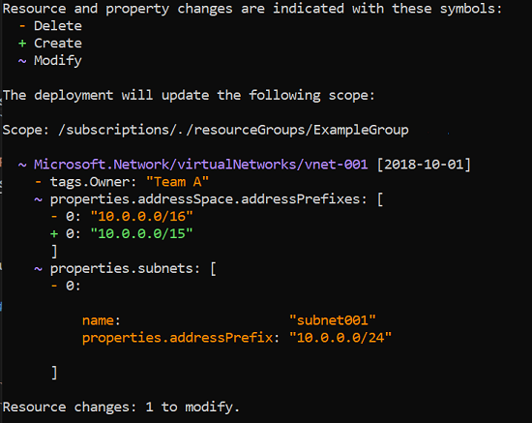
What If
Show what a template will do
Resource add / delete / update / etc
Review changes prior to deployment
Speed up edit/test cycles

Slide 12
Command Line
PowerShell
CLI
New-AzResourceGroupDeployment -Whatif …
New-AzSubscriptionDeployment -Whatif …
Requires:
Install-Module Az.Resources -RequiredVersion 1.12.1-preview -AllowPrerelease
PowerShell 6.x or 7.x
az deployment group what-if…
az deployment sub what-if…
Requires:
Azure CLI 2.5.0 or later

Slide 13
Change Types

Slide 14
Programmatic Results

Slide 15
Custom Functions

Slide 16
Embedded Scripts

Slide 17
Summary
Topic 1

Slide 18
Notes:
Thanks for listening to [Module Name].
My name is [Author].

